Slide 1
Visualization of feature-selectivity in ANNs and similarity to the visual pathway
By: Angel Huang, Elliot Smith, Matthew Shinkle, Miren Tamayo-Elizalde
---- Convoluted Okapis (Super-okapis pod)
TAs: Naga Karthik, Jonny Coutinho
August 2021

Slide 2
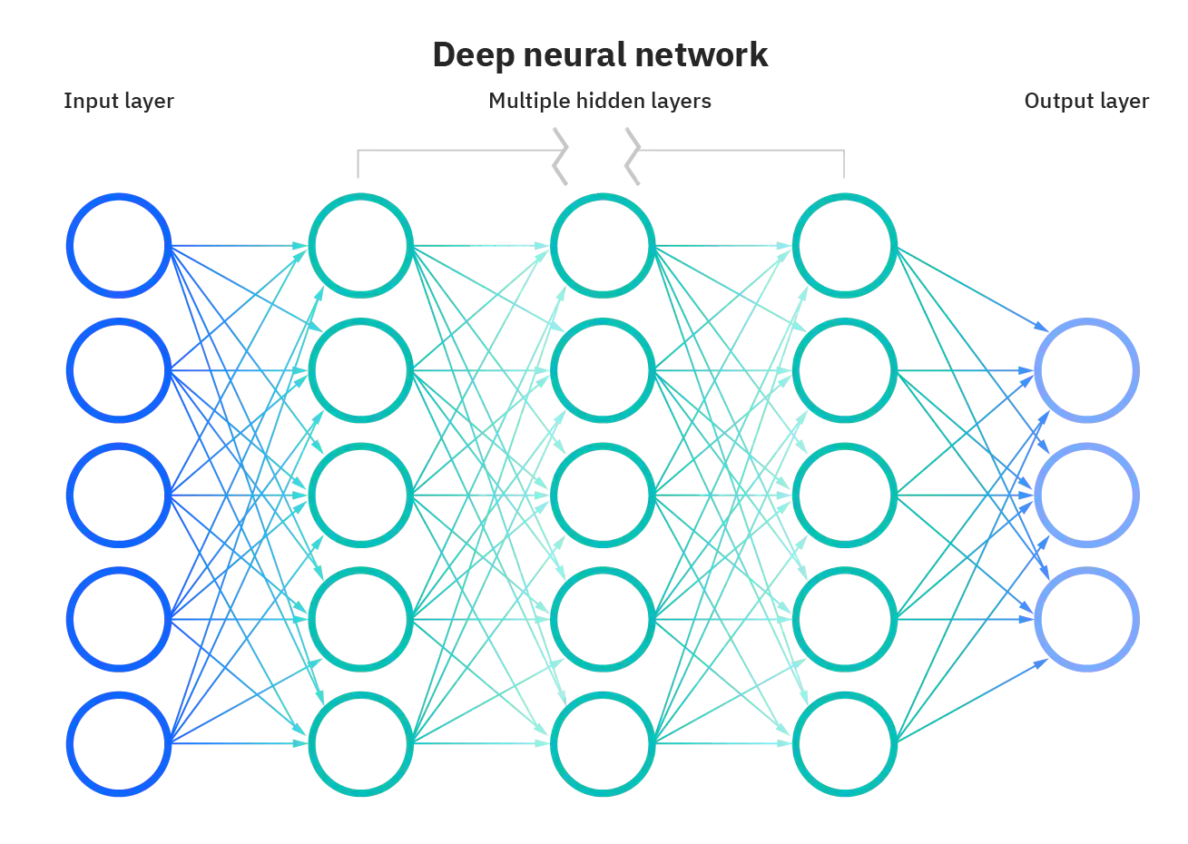
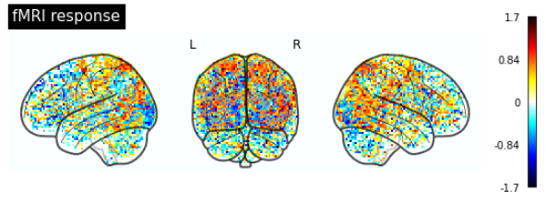
Motivation
Artificial neural networks (ANNs) show similarities to the brain in the way they process images.
Can we learn about selectivity and functionality of different brain areas by investigating representations learned by deep ANNs?
Algonauts2021 dataset
https://www.ibm.com/cloud/learn/neural-networks

Slide 3
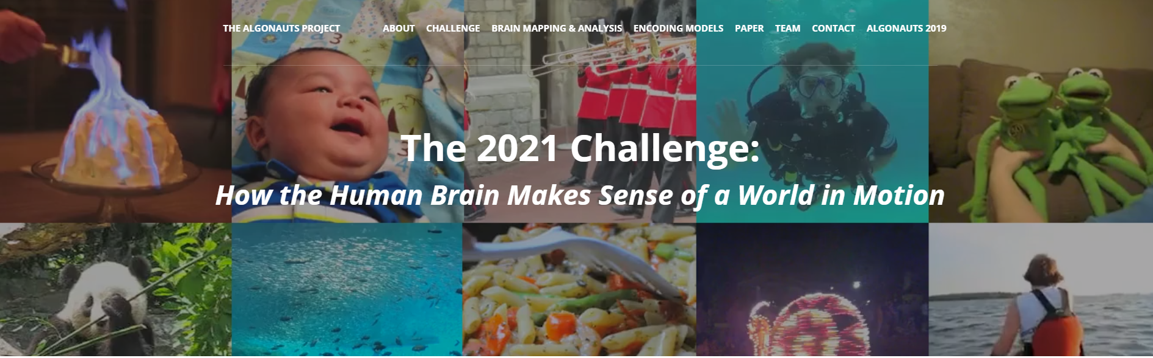
Project outline
3. Generate stimuli which should maximally activate units and voxels
2. Establish relationship between ANN PCs/units and fMRI voxels
fMRI responses
Reverse PCA
Input videos
CNNs
PCA
Linear
regres.
http://algonauts.csail.mit.edu/challenge.html
Algonauts2021 dataset
1. Characterize network unit responses to input videos

Slide 4
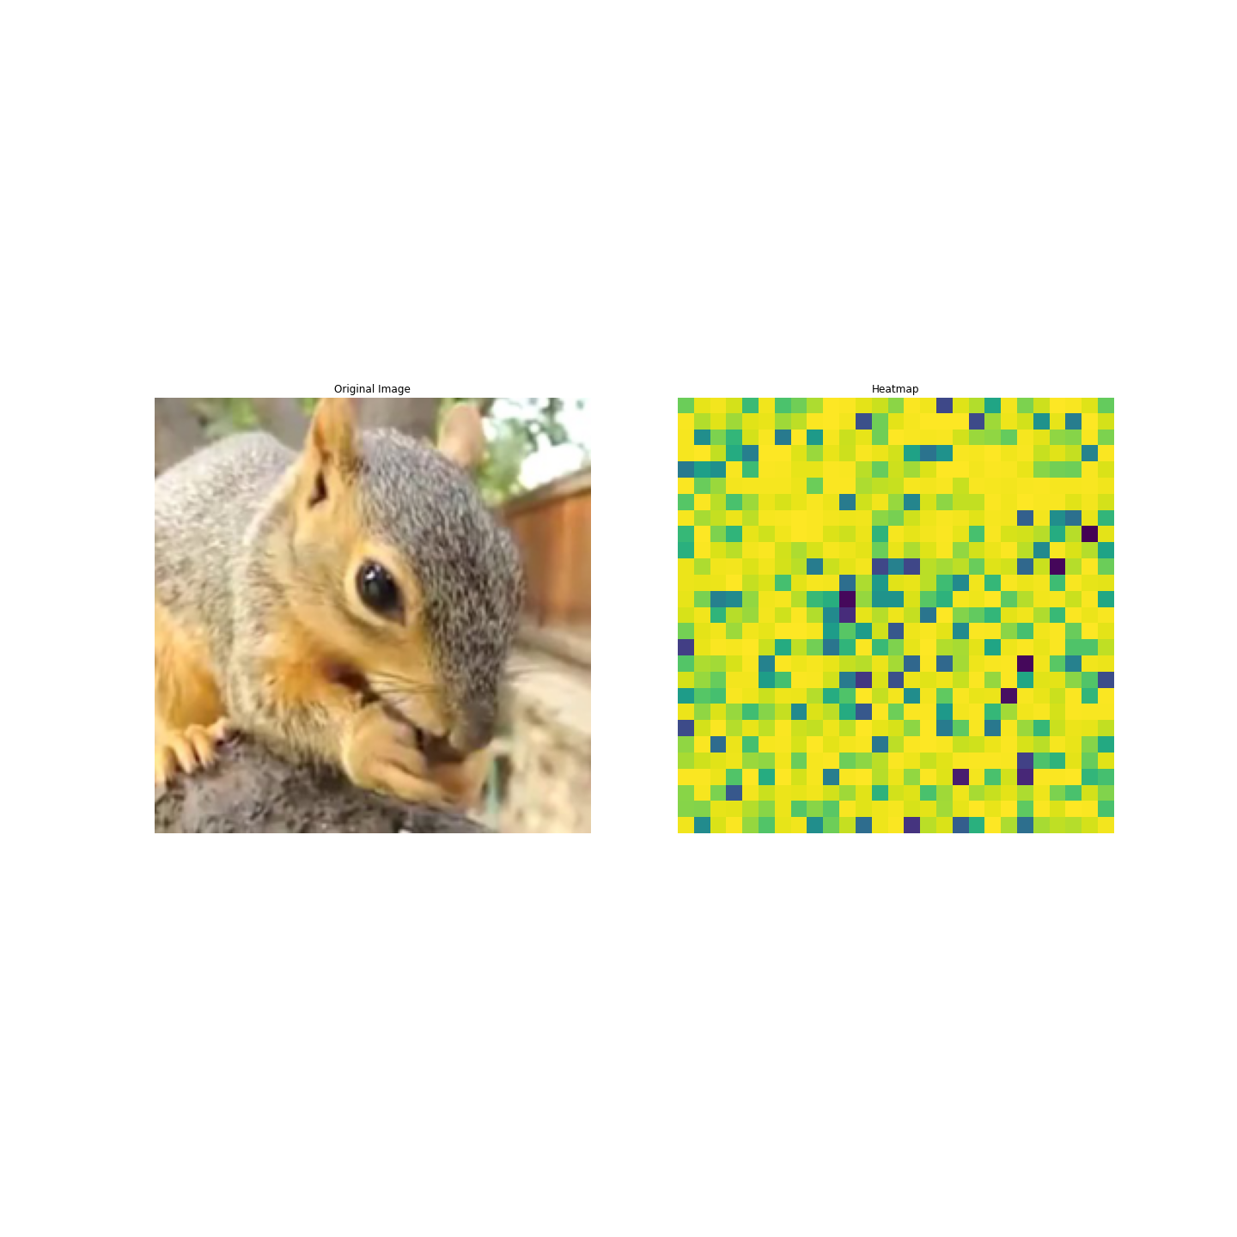
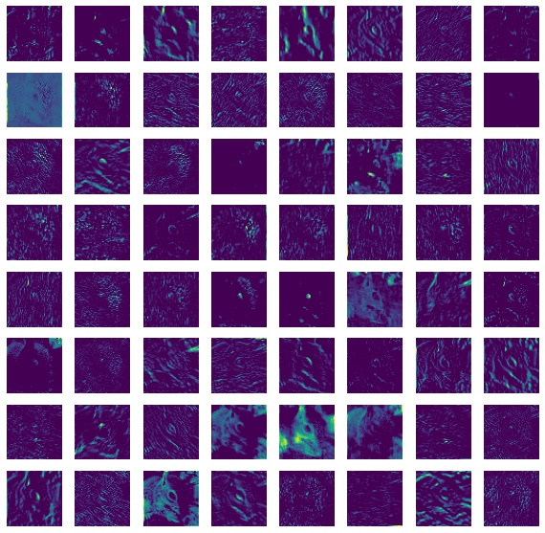
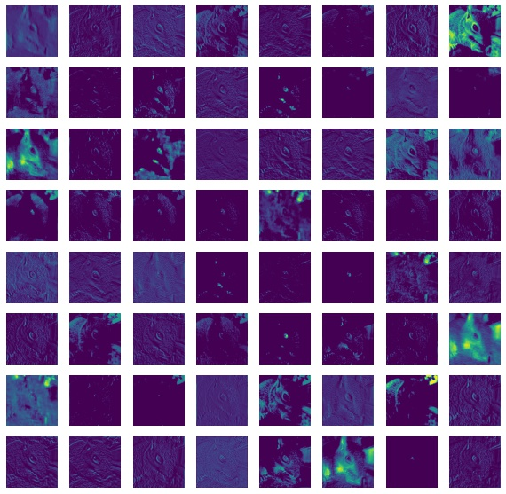
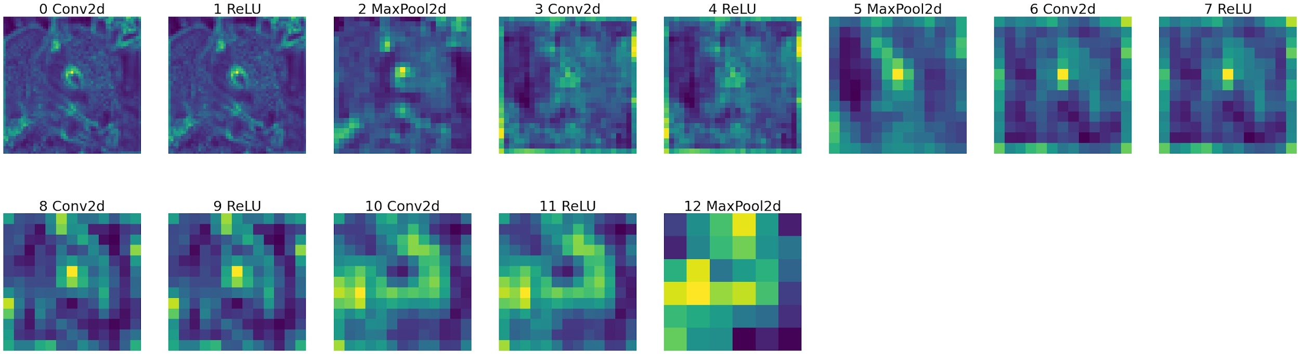
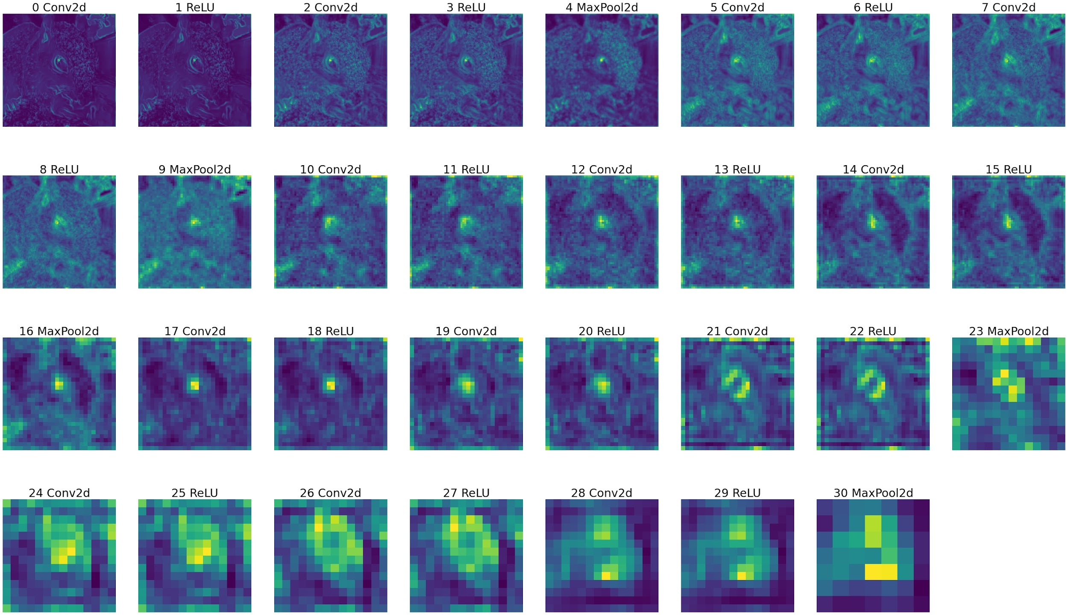
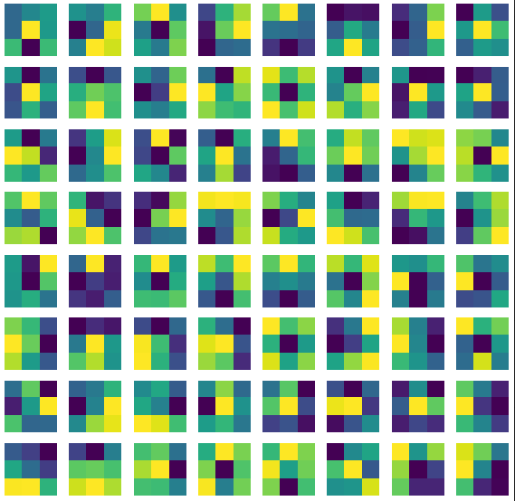
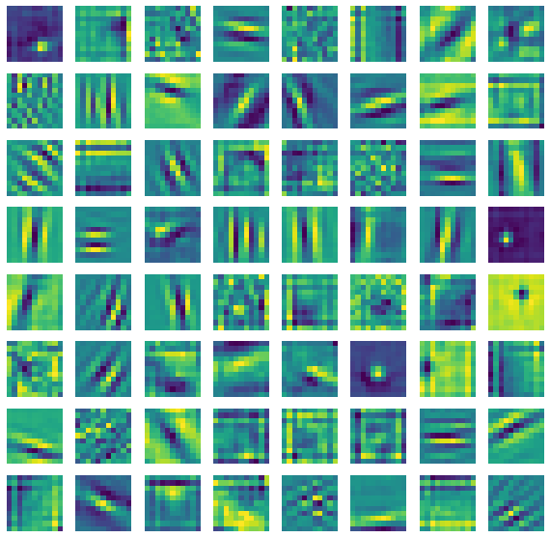
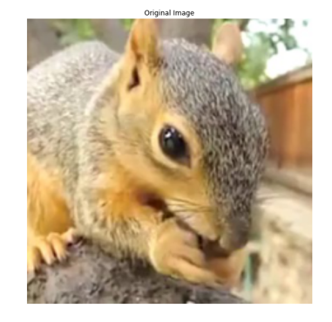
1.1 Comparison of features extracted from different ANNs
AlexNet
VGG16
Layer 1 filters
Layer 1 filters

Slide 5
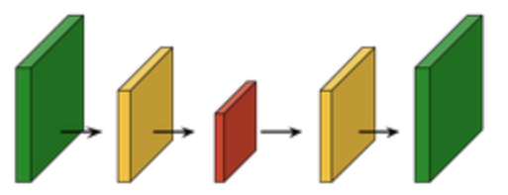
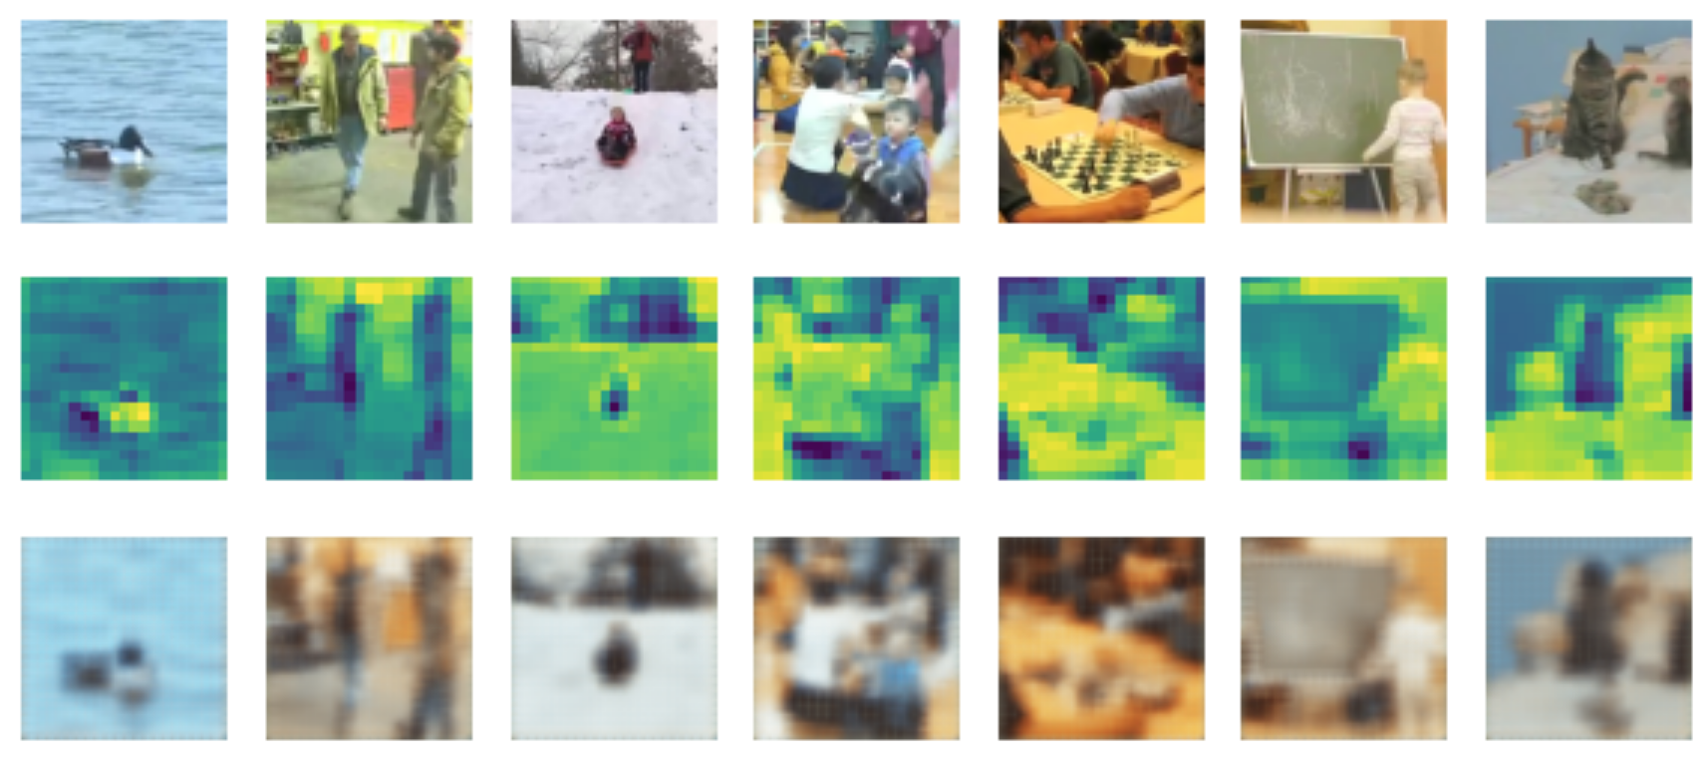
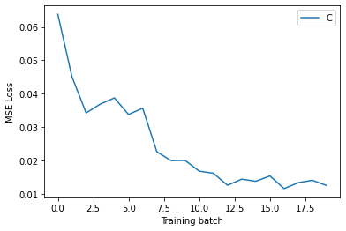
1.2. Reconstructed frames from convolutional AE
Conv2D
ReLu
MaxPool 2D
2 x
Input
Latent
Reconstructed
Input
Reconstructed
Latent
3 x 256 x 256
8 x 21 x 21
3 x 256 x 256

Slide 6
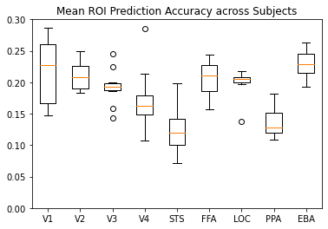
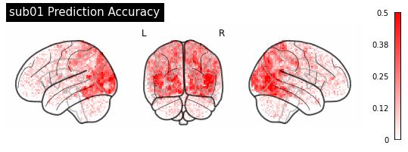
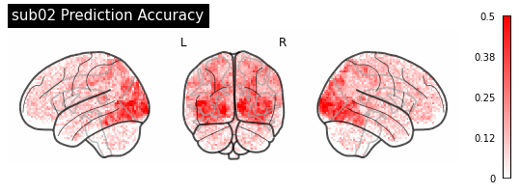
2. Establish mapping from ANN units to fMRI voxels
2. Establish relationship between ANN PCs/units and fMRI voxels
fMRI responses
Input videos
CNNs
PCA
Linear
regres.
http://algonauts.csail.mit.edu/challenge.html
Algonauts2021 dataset
1. Characterize network unit responses to input videos

Slide 7
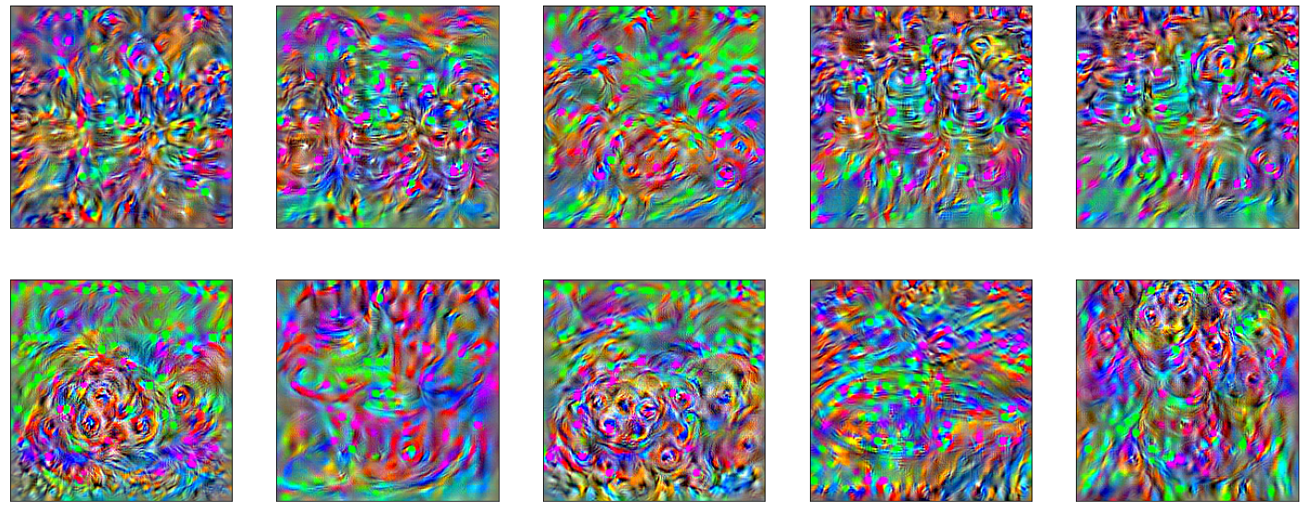
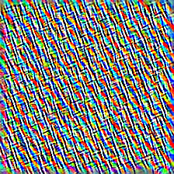
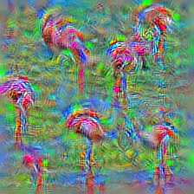
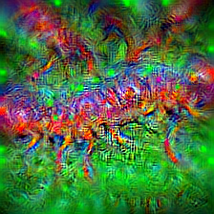
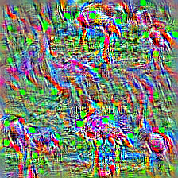
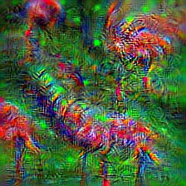
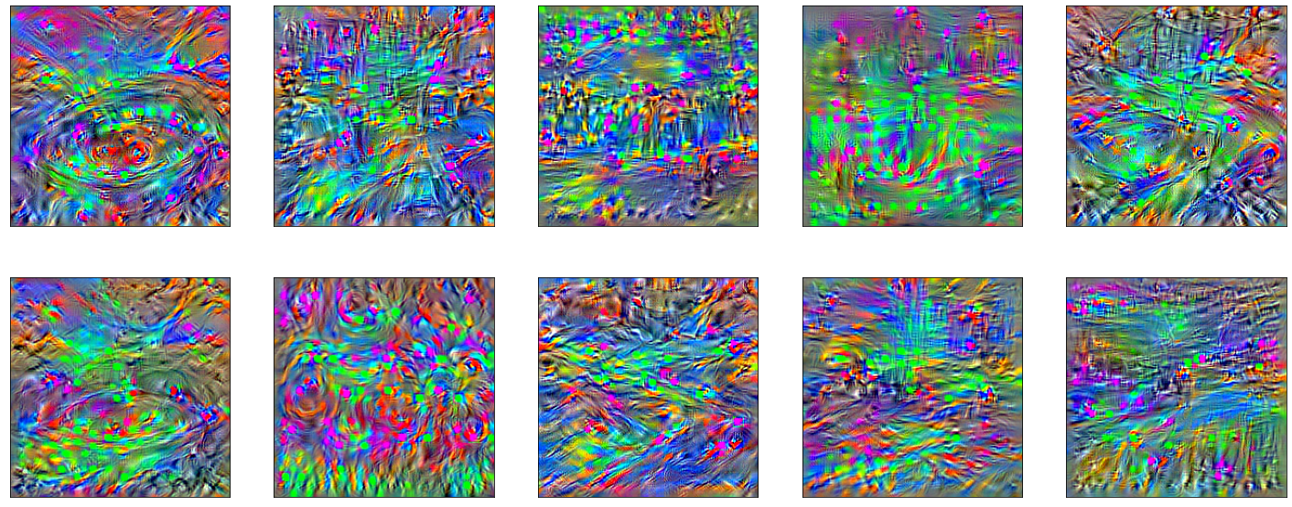
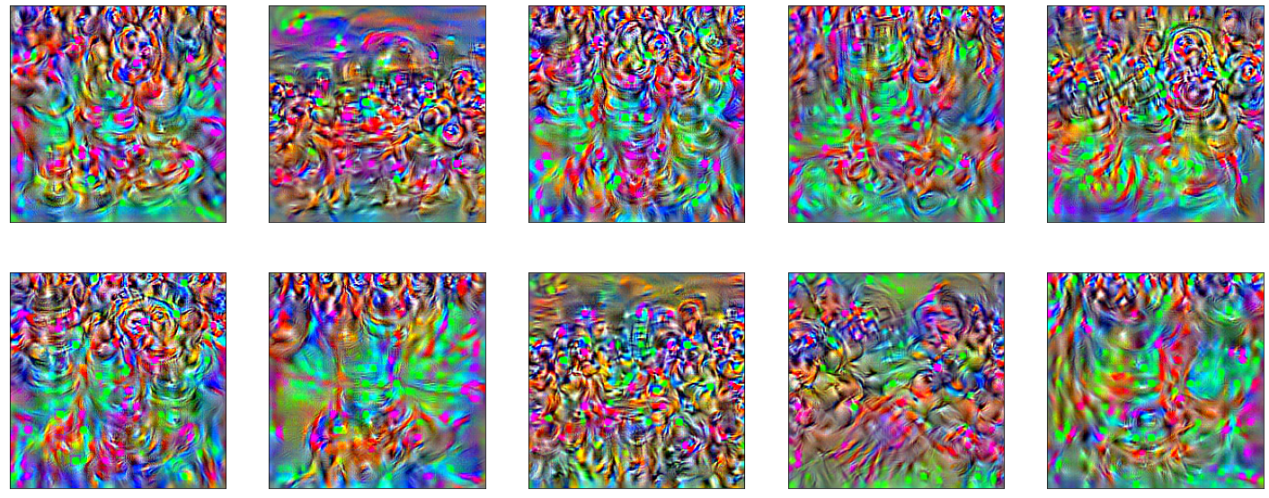
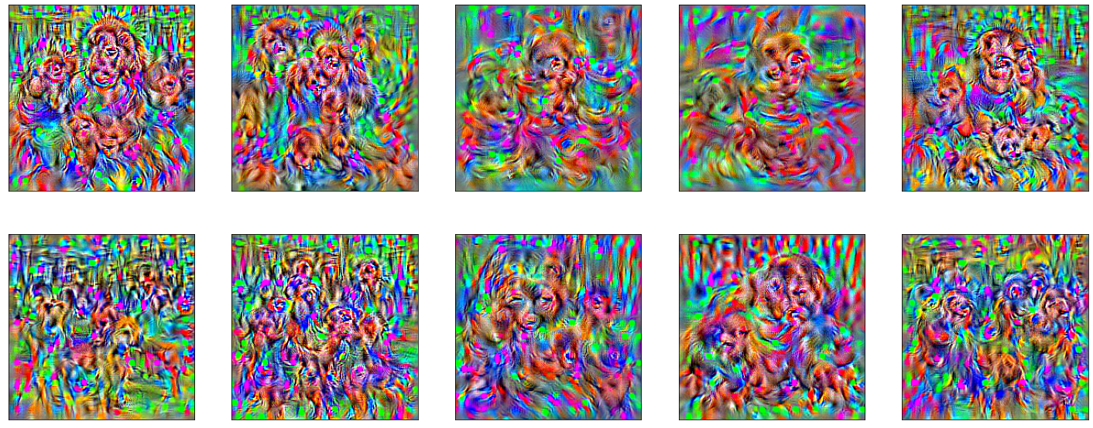
3. Maximal stimuli
V4
PPA
V1
FFA

Slide 8
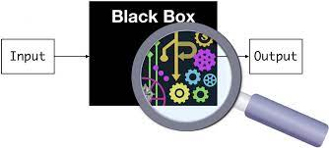
Conclusions and future directions
Thank you!
Conclusions
ANN layers visualization help model interpretability
Ability to decipher the specific functions of different brain regions by looking at the activations of highly correlated nodes in the network
Future directions
Apply 3D convolutions (2D images through time)
Apply attention to include associative/contextual information
Account for subjective perception/knowledge/experience captured in fMRI
Add semantic segmentation to autoencoder (need for labelled data)
https://towardsdatascience.com/black-boxes-and-their-intrusion-620aa3c4c56b
Notes:
Simple patterned images maximally activate ANN units with high correlation with early and mid-level visual cortex (V1, V2, V3, and V4)
More complex and human-interpretable shapes/images, such as body parts, animal-like shapes, and social scenes maximally activated network units tightly mapped to the higher-level cortex (EBA, FFA, STS, LOC)

